Slide 1
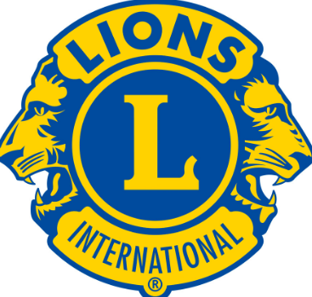
DECISION MAKING AND PROBLEM SOLVING
David Simmons
GLT COORDINATOR 2-S3

Slide 2
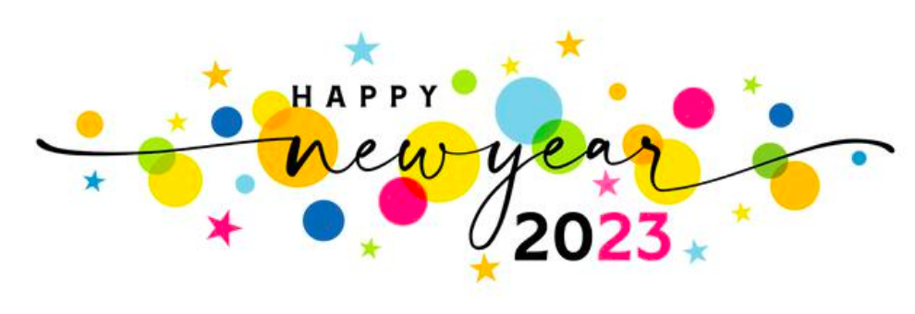

Slide 3
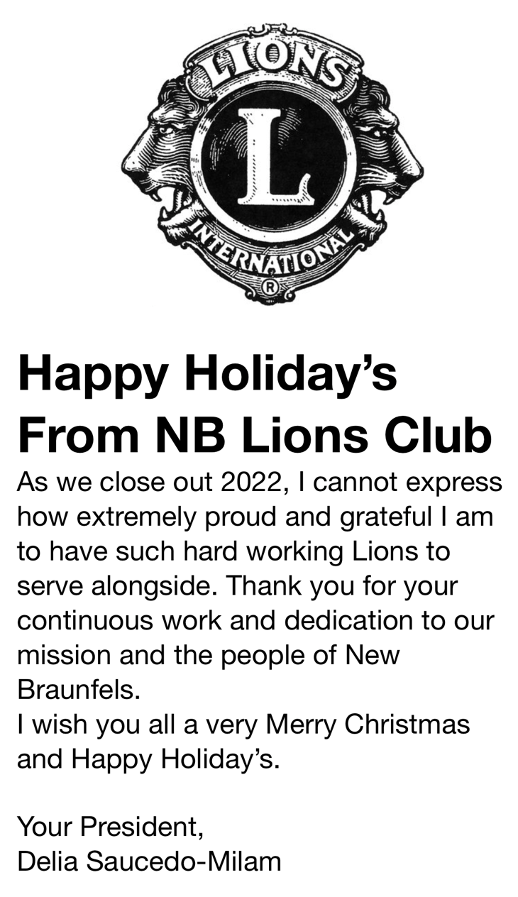

Slide 4
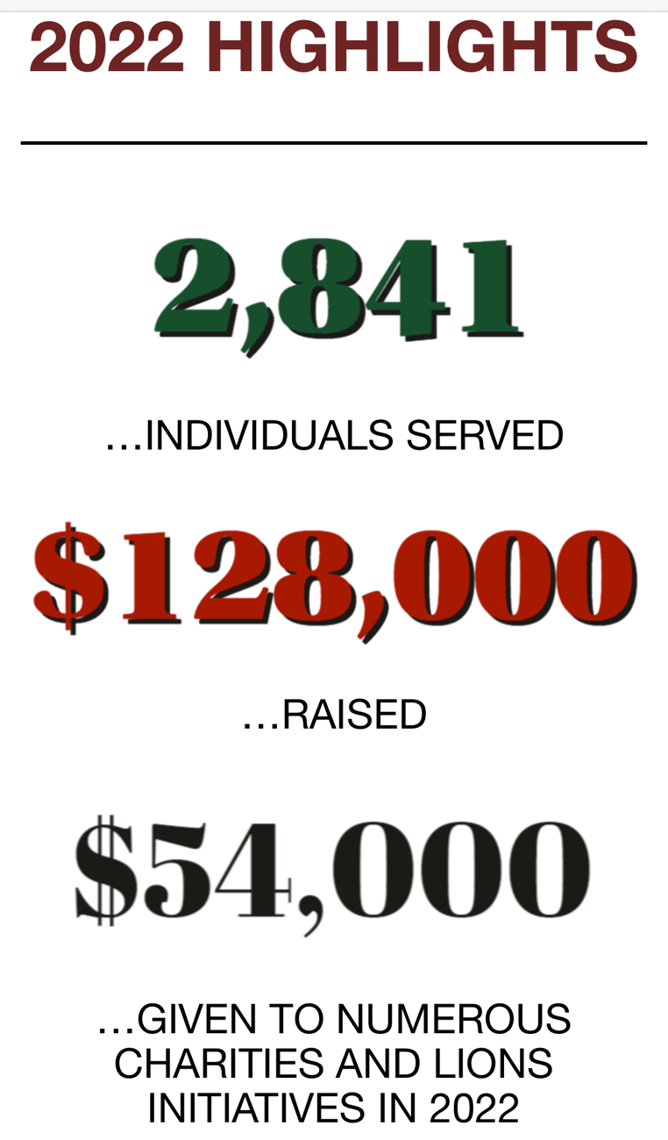

Slide 5
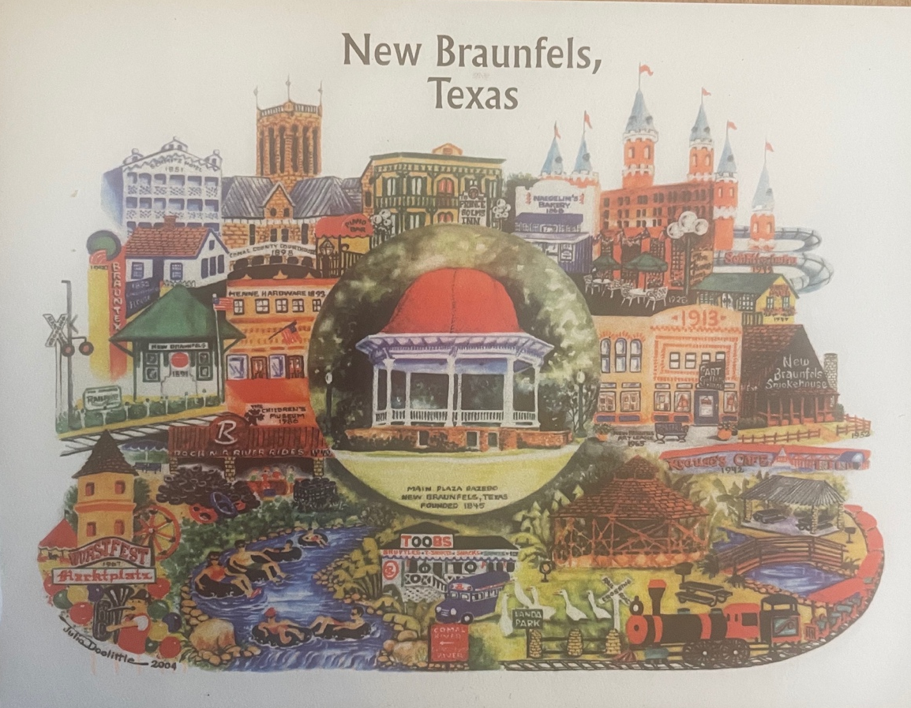

Slide 6
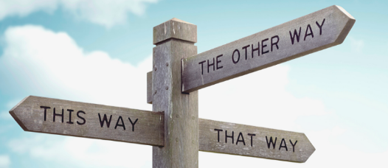
TURN TO YOUR PARTNER
“HOW DO YOU MAKE DECISIONS?”

Slide 7
TYPES OF DECISONS
NO STAKES – What to watch on TV; How much toothpaste to use; Which side of the bagel to butter?
LOW STAKES – Booking a Hotel; Buying a Printer?
HIGH STAKES – Job to take; House to Buy; University to attend; Which city to live?

Slide 8
HIGH STAKES DECISION MAKING STEPS
STEP 1: What really matters?
STEP 2: Gather facts/data about all your options.
STEP 3: ID a “front runner” and compare your options to it one by one. Once you have eliminated an option it is gone forever.
STEP 4: Choose one final choice. You can outsource to a small group (5 people or less).
STEP 5: COMMIT and EVALUATE

Slide 9
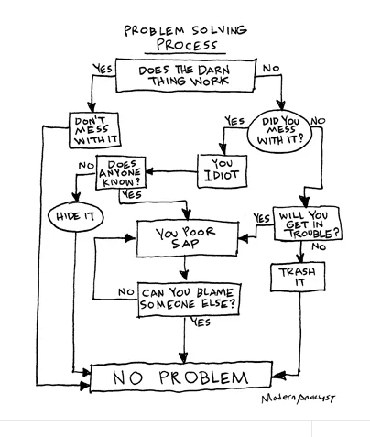

Slide 10
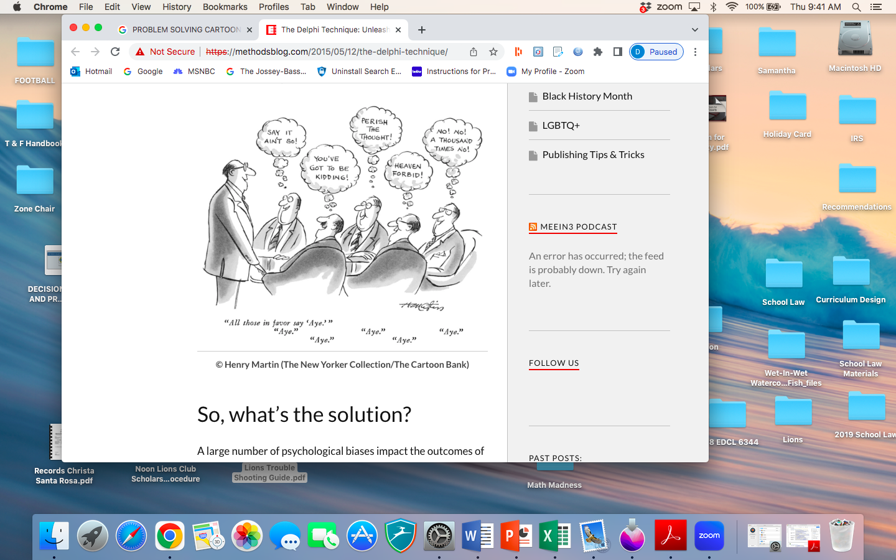

Slide 11
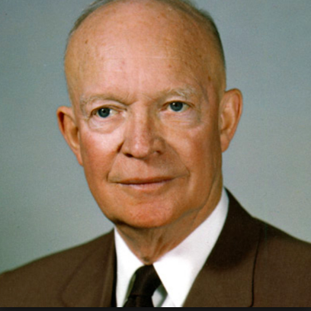
Here’s a task prioritization method from former U.S President Dwight D. Eisenhower.
In 1954, he said: “I have two kinds of problems: the urgent and the important. What is important is seldom urgent, and what is urgent is seldom important.”

Slide 12
THE ‘IMPORTANT’ CHECKLIST:
It will effect many people or projects if incomplete.
Other tasks depend on its completion.
It contributes a lot of value.
It’s low effort-high results (80/20 principle)

Slide 13
THE ‘URGENT’ CHECKLIST:
It is overdue.
It is due soon.
It demands immediate attention.
The consequences of not doing it are immediate.

Slide 14
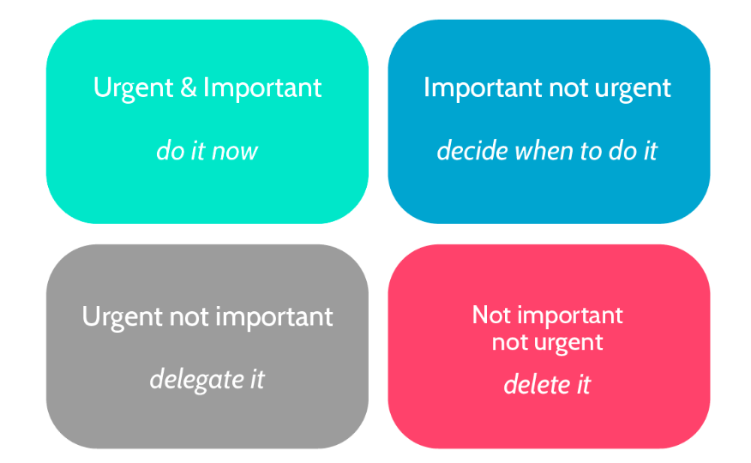

Slide 15
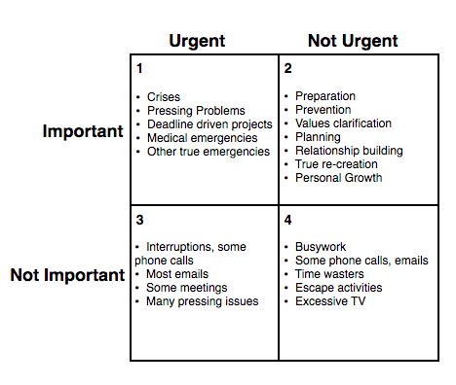

Slide 16
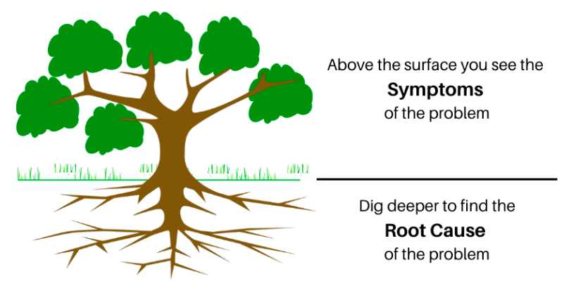

Slide 17
GROUP PROBLEM SOLVING
3 MINUTES
  Group looks at problem and brainstorms ideas and experiences from their backgrounds.
5-6 MINUTES
  Group plans a presentation for the rest of the audience. Can include: What kind of decision is required? and What is the priority of this decision? and a description of the problem.
3 MINUTES
  Group has a maximum time for presentation.

Slide 18
GROUP DECISION MAKING
VOTING – Use voting when you need a quick decision that considers equal input from group members.
RANKING – Use ranking when there are several good options from which to choose.
CONVERGENCE – Use convergence when you have time to collect suggestions and modify ideas.

Slide 19
1. WE DON’T KNOW WHY MEMBERS DROP OUT
• Find out by sending a local survey, similar to the LCI Dropped Member Survey
• Review the survey analysis on Why Lions Leave and How to Retain Them for more ideas

Slide 20
2. NO ONE WANTS TO TAKE LEADERSHIP POSITIONS
• Hold a club discussion about the value, expectations and benefits of being a club leader
• Start a mentoring program where each club leader actively trains their replacement throughout their year
• Contact your GLT district coordinator and request an Emerging Lion Leadership Institute

Slide 21
3. OUR LEADERS DON’T KNOW THEIR ROLES
• Encourage all club officers to become familiar with the Club e-Book specific to their positions
• Encourage incoming officers to attend the training offered by your District
• Make sure club officers know about the Club Officer training available to them through the Lions Learning Center
• Develop a Club Activity Calendar to help leaders prepare for annual organizational activities

Slide 22
4. OUR LEADERS STAY IN THE SAME POSITONS YEAR AFTER YEAR
• Encourage club leaders to practice succession planning as encouraged in the Club President/First Vice President e-Book
• Take the Succession Planning training course in the Lions Learning Center (available in February 2020)

Slide 23
5. WE DON’T KNOW HOW TO PREVENT CLUB LOSS
• Find out by sending a local survey, similar to the LCI Dropped Member Survey
• Review the survey analysis on Why Lions Leave and How to Retain Them for more ideas

Slide 24
6. GUESTS COME TO MEETINGS BUT DON’T BECOME MEMBERS
• Create a welcome plan for prospective members who come to a meeting and discuss how each club member can contribute
• Share the LCI Fact Sheet and Benefits of Membership flyer with prospective members
• Learn more about conducting a great meeting with the Lions Learning Center courses on Meeting Management and Public Speaking

Slide 25
7. OUR CLUB IS NOT WELL KNOWN
• Choose from 30 Marketing Ideas to help promote your club
• Take our Lions Learning Center course on Public Relations
• Review the Social Media resources available from Lions Smile
• View the PR Guide webpage for more ideas, tools and resources

Slide 26
8. WE DON’T DO MEANINGFUL PROJECTS
• Conduct a Community Needs Assessment and discover new ways to serve
• Share our Service Impact Stories and solicit ideas for new service projects
• Complete Assessment 1: Enhance Service Impact in the Club Quality Initiative for ideas

Slide 27
9. MEMBERS SKIP MEETINGS
• Ensure member communications are being sent a week prior and a day prior to meetings
• Ask your members by using the How are your ratings survey
in the Club Quality Initiative, complete Assessment 3: Pursue Club Organizational Excellence
• Review quick tips for Meeting Management and Listening and Communication
• Have club leaders complete the Membership Satisfaction Guide

Slide 28
10. MEMBERS DON’T PARTICIPATE IN MEETINGS
• Use Your Club, Your Way! for new meeting ideas
• Get your whole club involved by participating in the Club Quality Initiative
• Learn more about Team Motivation, Promoting Innovation and Valuing Member Diversity through the Lions Learning Center
• Schedule a variety of activities for your club and communicate them with a Club Activity Calendar
Lions Clubs Troubleshooting Guide

Slide 29
DECISION MAKING STYLES
“STYLE MATCHES THE SITUATION…”
DIRECTIVE – is rational, bases decisions on pros/cons and experience.
ANALYTIC – seeks and uses information and observation.
CONCEPTUAL – considers creativity, risk taking, and long-term results.
BEHAVIORAL – emphasizes options and group discussion.

Slide 30
W
hen you
are being
run out of
town,
make it
look like a
parade…

Slide 31
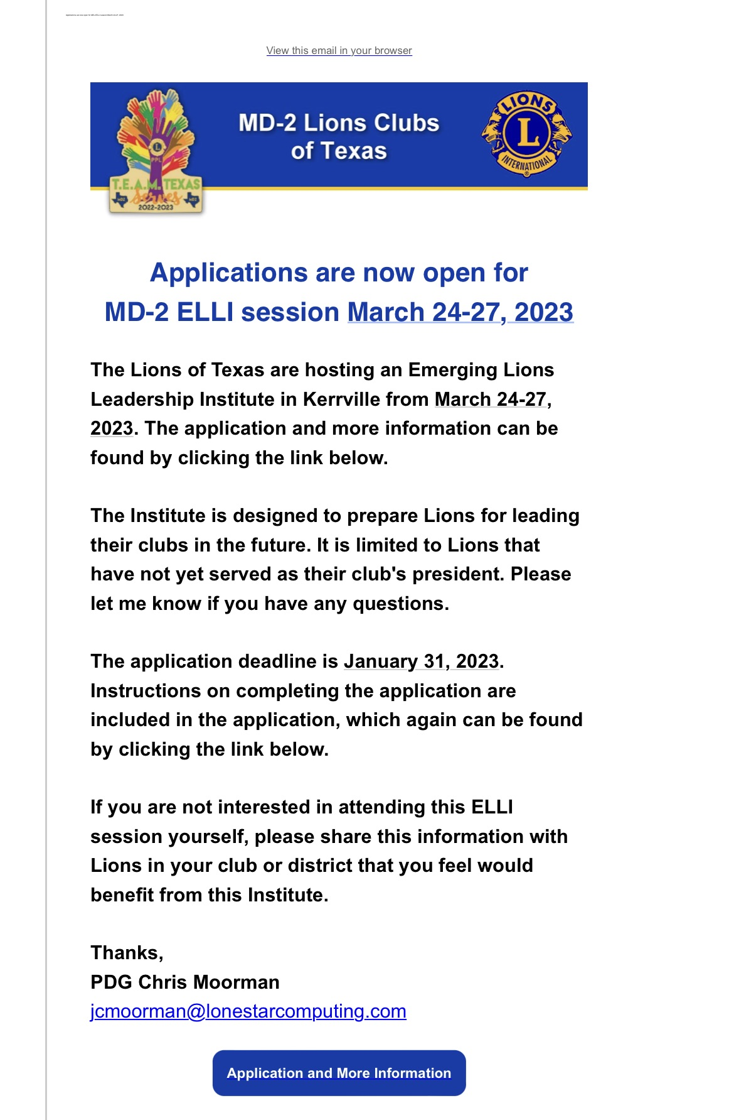

Slide 32
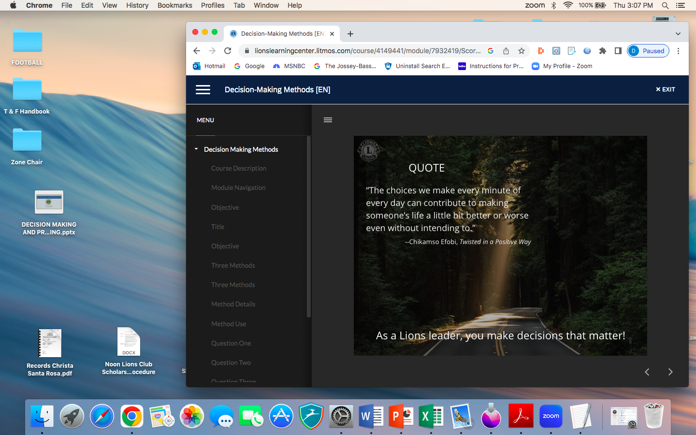

Slide 33
Thank You! CONTACT ME…
LION DAVID SIMMONS
PHONE: 210 386 9454
Email: dlsimmons_87@hotmail.com

